Slide 1

Coding Practice
-Chandan Naresh

Slide 2
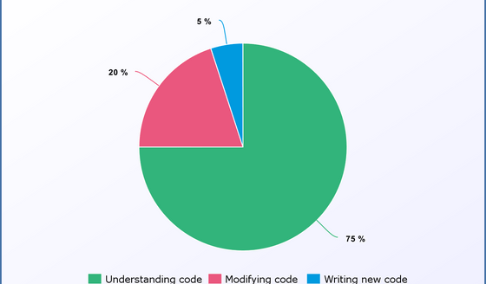
What is Clean Code
Clean Code is piece of code which is easy to read and understand
Notes:
The average developer spends 75% of the time understanding code, 20% of the time modifying existing code and only 5% writing new
A slight additional time of a single developer spent on readability reduces the understanding time for teammates. This practice becomes important when the application size grows since the understanding time increases with complexity.
Reading meaningful code is easy. Nevertheless, writing meaningful code is the opposite: you have to learn clean code practices and put constant effort to express yourself clearly.

Slide 3
The Most Common Coding Mistakes
1) Bad variable naming
2) Not using comments
3) Not keeping code formatting consistent
4) No Version control for projects
5) Not using the debugger
6) Creating too big function
Notes:
There are many mistakes a new programmer can make. Today, you will learn the most common mistakes that beginners make, and how you can avoid them.
1) Bad variable naming
This is by far the most common mistake beginner programmers make. Name your variables and functions as if your mom was going to have to read and understand what each one means (assuming your mom isn’t a programmer, of course).
In three months, are you going to remember what the variable you named “
dsld” means, or what that function you creatively named “nstnc_crt” does?
Example of poor variable naming:
Example of consistent variable naming:
2) Not using comments
Comments are an amazing way to remind you what a piece of code does. Too many beginners don’t utilize comments at all, which makes code messy and hard to read. However, there is a fine balance between how many comments you should use in your code.
If you add too many comments, you’ll have to change the comments every time you change the code that it’s describing. It is best to use comments only when a piece of code is not completely self-explanatory.
3) Not keeping code formatting consistent
It doesn’t matter if you put the brackets on the same line as the “
if” statement, or if you name variables with camel case or underlines. Just make sure you keep it consistent. If you don’t do this, your will code look very amateur, and hard to maintain. Example of inconsistent code formatting:
Example of more consistent code formatting:
4) Not backing up your project
This is a mistake that could lose you years of your life. Backing up your code is extremely important, even if you are not working on a team. Do not be intimidated by GitHub! They created a great application called GitHub Desktop. GitHub Desktop makes it extremely easy to sync & save your work without even touching the command line. Best of all, it’s free!
5) Using an overly-complicated language
Don’t feel pressured to code in a language that you’re intimidated by just because that’s what many others do, and especially don’t code a custom engine. There are multitudes of easy-to-understand languages that are very beginner-friendly. And, once you know one language, it’s very easy to learn any other language.
6) Not utilizing the debugger
When you run into a code error that you do not know how to solve, don’t make the mistake of just diving into the code and reading. Use the debugger. Most IDEs have them. With the debugger, it makes solving issues a breeze; you can watch your code run line-by-line, so you can see exactly what’s going wrong.
7) Creating functions that are too big
Don’t make functions that take in many inputs, or functions that only accomplish one very specific task. Break up your function into multiple other functions, which are easier to read and maintain. Example of a function which takes in too many inputs:
Example of a function which takes in an appropriate amount of inputs
Hopefully, these tips have helped you out. Have some tips of your own? Let us know in the comments below!
Happy coding! 🙂

Slide 4
Clean-code-naming-conventions
When coding, you should consider naming variables, functions, arguments, classes, packages, source files, and directories that contain those source files, etc
You can introduce several VSCode plugins like ESLint, Prettier+ESLint — Code formatter + Linter, Bracket Pair Colorizer, Beautify, Code Spell Checker, TypeLens, npm Intellisense, and GitLens, etc for your team.
Notes:
https://medium.com/@pabashani.herath/clean-code-naming-conventions-4cac223de3c6

Slide 5
Some standards for naming
1. Choose descriptive and unambiguous names.
2. Make meaningful distinctions.
3. Use pronounceable names.
4. Use searchable names.
5. Replace magic numbers with named constants.
6. Avoid encodings. Don’t append prefixes or type information.

Slide 6
Good practices
When you naming classes, use nouns and adjectives like Customer, Product, and Student, etc
Create meaningful names: while naming a variable use meaningful name instead of comment
Name should tell why it exists and its usage.
Eg: FetchValue() vs GetValue() vs RetrieveValue()
Avoid using letters like a, b, x, or y as variable names unless there is a good reason (loop variables are an exception)
Avoid Keywords and Noise Words
Eg: Object, Manager, Data, Info, The
Instead of customerData, use customer
Instead of employeeInfo, use employee
Bad variable naming | Good variable naming
var b; // elapsed time in days | var elapsedTimeInDays;
 | Var daysSinceCreation
Notes:
How to Create Meaningful Names
Do not use comments to explain why a variable is used. If a name requires a comment, then you should take your time to rename that variable instead of writing a comment.
"A name should tell you why it exists, what it does, and how it is used. If a name requires a comment, then the name does not reveal its intent." – Clean CodeBad:
var d; // elapsed time in days

Slide 7
Replace magic numbers with named constants.
Avoid encodings. Don’t append prefixes or type information.
You can use:
Because there is no need to mention the data type in the name
const MAX_IMAGE_WIDTH = 100; const HOURS_PER_DAY = 24;
let accountList; // Eg: Disinformation let nameString; // Eg: Encoding let salaryFloat;
let accounts; let name; let salary;
Notes:
https://medium.com/@pabashani.herath/clean-code-naming-conventions-4cac223de3c6
Replace magic numbers with named constants.
Another point is, when you are using some constant values, define them using searchable words like the below example. It gives more understandable to other developers.
Avoid encodings. Don’t append prefixes or type information.
And also rather than using terms with a strong sense distinct from what we want to say (disinformation) and unnecessary encodings of data types along with the variable name like the below examples:

Slide 8
Don’t Be Offensive/Cute
Don’t be a serial killer behind your code
function killThemAll(); function whack();
Vs
function removeAll(); function deleteItem();
Notes:
Names you use for your functions will be read by many people. If you use words like kill, whack, and throw, it will not give a good image of the developer.
Naming convention should be generic, and as professional as possible, and should not include any cultural slang.
So you can write it like ;

Slide 9
Good Practice- Cont.
Use native data types instead of Common Type systems
Eg: Use int instead of int32/int 64
Use Pascal case for class names. Use noun and avoid underscores and prefixes
Eg: public partial class About : Customer
{….
}
Property
Use PascalCase for property. Do not use Get and Set as prefix with property name.
private int _payment = 100;
public int Payment
{
get
{
return _payment;
}
set
{
_payment = value;
}
}
Interface Always use letter "I" as prefix with name of interface. Post letter I, use PascalCase.
public interface ICustomer
{
/// <summary>
/// Check customer is exists or not
/// </summary>
/// <returns>return bool value</returns>
bool ValidateCustomer();
}

Slide 10
Good practice- Functions
Keep function names small and simple.
Avoid too big names
Use Camel case/Pascal case for method names as per language
Use maximum 7 parameters
Do not use all CAPS
Always use camelCase with method arguments and local variables
Eg: public string GetCustomer(string custId)
{
//...
}
Every function is an action, so the name should contain at least one verb.
Eg: reloadCustomerData() means to reload customer data
Eg: isHoliday() means checking if the date is a holiday or no.

Slide 11
Strongly typed
Enforces strict restrictions on intermixing of values with differing data types.
The language compiler enforces the data typing and use compliance.
Smalltalk, Perl, Ruby, Python, and Self are examples of "strongly typed"
Consistency of Results
prevents the programmer from inventing a data type not anticipated by the developers
Notes:
Enforces strict restrictions on intermixing of values with differing data types. When the restrictions are violated, and error (exception) occurs.
The language compiler enforces the data typing and use compliance.
Smalltalk, Perl, Ruby, Python, and Self are examples of "strongly typed" in the Typing errors are prevented at runtime and they do little implicit type conversion, but these languages make no use of static type checking: the compiler does not check or enforce type constraint rules.
An advantage of strong data typing is that it imposes a rigorous set of rules on a programmer and thus guarantees a certain consistency of results
A disadvantage is that it prevents the programmer from inventing a data type not anticipated by the developers of the programming language and it limits how "creative" one can be in using a given data type.

Slide 12
Concept of Functional, OOP & Procedural Application

Slide 13
Functional Programming
“Functional programming (FP) is a programming paradigm — a style of building the structure and elements of computer programs. It treats computation as the evaluation of mathematical functions and avoids changing-state and mutable data.” — Wikipedia
organize your code into multiple functions where each function works on its own.
emphasis on expressions and declarations rather than execution of statements
Check(a,b)
{
return a+b;
}
Eg: XSLT, SQL, F#

Slide 14
Advantages | Limitations
Easy to debug Easier to test and execute Unit testing Parallel processing and concurrency Hot code deployment and fault tolerance Offers better modularity with a shorter code Increased productivity of the developer Supports Nested Functions Functional Constructs like Lazy Map & Lists, etc. | It is difficult to understand for the beginner Hard to maintain as many objects evolve during the coding Needs lots of mocking and extensive environmental setup Re-use is very complicated and needs constantly refactoring Objects may not represent the problem correctly

Slide 15
Procedural programming
instructs a device on how to finish a task in logical steps.
uses a linear top-down approach and treats data and procedures as two different entities
divides the program into procedures, which are also known as routines or functions
simply containing a series of steps to be carried out.
involves writing down a list of instructions to tell the computer what it should do step-by-step to finish the task at hand.
Eg: FORTRAN, COBOL, ALGOL, BASIC, C and Pascal.
Notes:
Key Features of Procedural Programming
The key features of procedural programming are given below:
Predefined functions: A predefined function is typically an instruction identified by a name. Usually, the predefined functions are built into higher-level programming languages, but they are derived from the library or the registry, rather than the program. One example of a pre-defined function is ‘charAt()’, which searches for a character position in a string.
Local Variable: A local variable is a variable that is declared in the main structure of a method and is limited to the local scope it is given. The local variable can only be used in the method it is defined in, and if it were to be used outside the defined method, the code will cease to work.
Global Variable: A global variable is a variable which is declared outside every other function defined in the code. Due to this, global variables can be used in all functions, unlike a local variable.
Modularity: Modularity is when two dissimilar systems have two different tasks at hand but are grouped together to conclude a larger task first. Every group of systems then would have its own tasks finished one after the other until all tasks are complete.
Parameter Passing: Parameter Passing is a mechanism used to pass parameters to functions, subroutines or procedures. Parameter Passing can be done through ‘pass by value’, ‘pass by reference’, ‘pass by result’, ‘pass by value-result’ and ‘pass by the name’.

Slide 16
Advantages | Limitations
Excellent for general-purpose programming The coded simplicity along with ease of implementation of compilers and interpreters The source code is portable, therefore, it can be used to target a different CPU as well The code can be reused in different parts of the program, without the need to copy it Less load on memory The program flow can be tracked easily | Harder to write when Procedural Programming is employed Often not reusable, which may pose the need to recreate the code if is needed to use in another application Difficult to relate with real-world objects The importance is given to the operation rather than the data, which might pose issues in some data-sensitive cases The data is exposed to the whole program, making it not so much security friendly

Slide 17
Object Oriented Programming
relies on the concept of classes and objects.
used to structure a software program into simple, reusable pieces of code blueprints (usually called classes)
object’s
own procedures can access and often modify the data fields of itself.
widely used programming languages (such as C++, C#, Java, Python, etc.
Languages that support object-oriented programming (OOP) typically use inheritance for code reuse and extensibility in the form of either classes or prototypes.

Slide 18
Advantages | Limitations
A real-world idea can be demonstrated, as everything in OOP is treated as an object. Programs are easier to test and maintain because of encapsulation Development is faster as we develop classes parallel instead of sequentially. Provides greater security due to data abstraction. The outside world cannot access the hidden data. Reusability can be achieved by using classes that have been already written. | A programmer needs to plan beforehand for developing a program in OOP. The size of programs developed with OOP is bigger than those developed with a procedural approach. Since OOP programs are larger in size, the execution time for these programs is also more.

Slide 19
Principles, Patterns & Clean Architecture

Slide 20

10-coding-principles-every-programmer-should-learn
DRY(Don’t Repeat Yourself)
SRP(Single Responsibility Principle)
SOLID
SOC(Separation of Concern)
YAGNI(You Aren’t Going to Need It)
KIS(Keep it simple)
ISP(Interface Segregation Principle)
Delegation
LSP(Liskov Substitution Principle)
Dependency Inversion

Slide 21
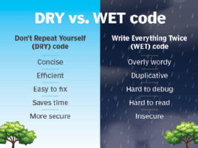
DRY (Don’t repeat yourself)
don’t write duplicate code
It states that a piece of code should be implemented in just one place in the source code.
create a common function or abstract your code to avoid the repetition in your code
Notes:
1. DRY (Don’t repeat yourself)
Our first object-oriented design principle is DRY, as the name suggests DRY (don’t repeat yourself) means don’t write duplicate code, instead use Abstraction to abstract everyday things in one place.
If you have a block of code in more than two places, consider making it a separate method, or if you use a hard-coded value more than one time, make them public final constant. The benefit of this Object-oriented design principle is in maintenance.
It’s important not to abuse it, duplication is not for code, but for functionality.
It means if you have used standard code to validate OrderId and SSN, it doesn’t mean they are the same, or they will remain the same in the future.
By using standard code for two different functionality or thing, you tightly couple them forever, and when your OrderId changes its format, your SSN validation code will break.
So beware of such coupling and don’t combine anything which uses similar code but is not related. You can further check out the Basics of Software Architecture & Design Patterns in Java course on Udemy to learn more about writing the right code and best practices to follow while designing a system.

Slide 22
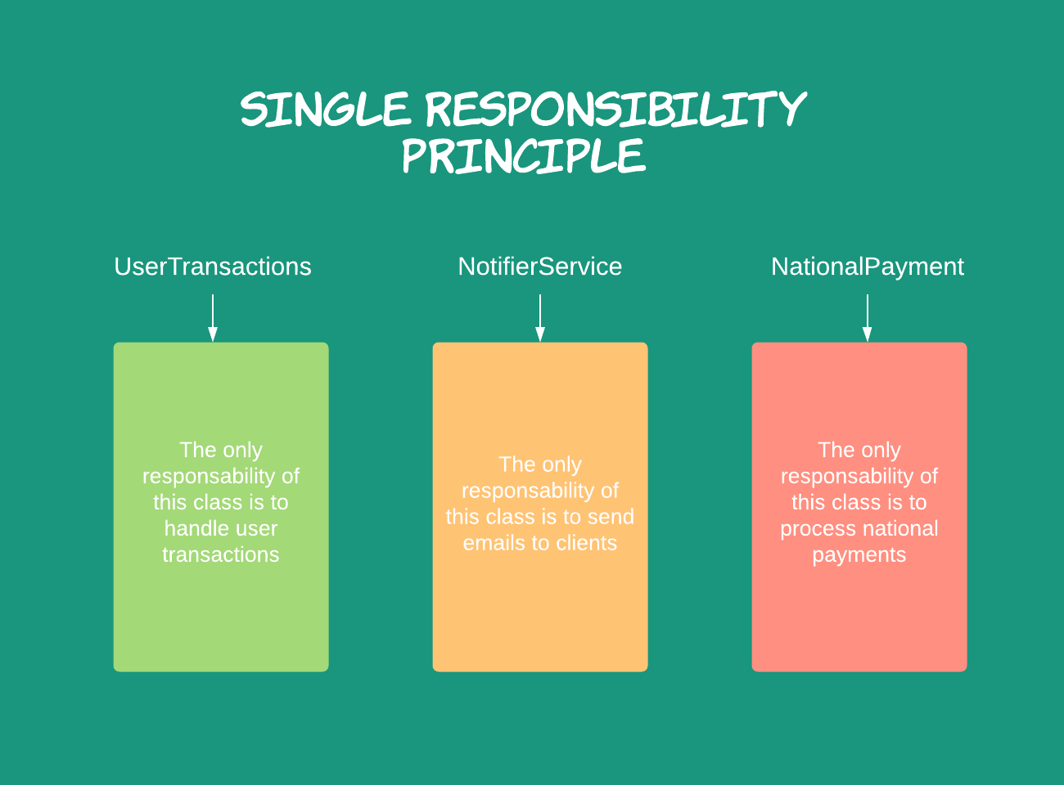
SOLID
Single responsibility, Open-closed, Liskov substitution, Interface Segregation, and Dependency inversion. These principles are given by Robert C. Martin
helps in reducing tight coupling
Loosely coupled classes minimize changes in your code, helps in making code more reusable, maintainable, flexible and stable.
Notes:
https://www.geeksforgeeks.org/solid-principle-in-programming-understand-with-real-life-examples/
The SOLID principle helps in reducing tight coupling. Tight coupling means a group of classes are highly dependent on one another which you should avoid in your code. Opposite of tight coupling is loose coupling and your code is considered as a good code when it has loosely-coupled classes. Loosely coupled classes minimize changes in your code, helps in making code more reusable, maintainable, flexible and stable. Now let’s discuss one by one these principles…
1. Single Responsibility Principle: This principle states that “a class should have only one reason to change” which means every class should have a single responsibility or single job or single purpose. Take the example of developing software. The task is divided into different members doing different things as front-end designers do design, the tester does testing and backend developer takes care of backend development part then we can say that everyone has a single job or responsibility. Most of the time it happens that when programmers have to add features or new behavior they implement everything into the existing class which is completely wrong. It makes their code lengthy, complex and consumes time when later something needs to be modified. Use layers in your application and break God classes into smaller classes or modules.
2. Open/Closed Principle: This principle states that “software entities (classes, modules, functions, etc.) should be open for extension, but closed for modification” which means you should be able to extend a class behavior, without modifying it. Suppose developer A needs to release an update for a library or framework and developer B wants some modification or add some feature on that then developer B is allowed to extend the existing class created by developer A but developer B is not supposed to modify the class directly. Using this principle separates the existing code from the modified code so it provides better stability, maintainability and minimizes changes as in your code.
3. Liskov’s Substitution Principle: The principle was introduced by Barbara Liskov in 1987 and according to this principle “Derived or child classes must be substitutable for their base or parent classes“. This principle ensures that any class that is the child of a parent class should be usable in place of its parent without any unexpected behavior. You can understand it in a way that a farmer’s son should inherit farming skills from his father and should be able to replace his father if needed. If the son wants to become a farmer then he can replace his father but if he wants to become a cricketer then definitely the son can’t replace his father even though they both belong to the same family hierarchy. One of the classic examples of this principle is a rectangle having four sides. A rectangle’s height can be any value and width can be any value. A square is a rectangle with equal width and height. So we can say that we can extend the properties of the rectangle class into square class. In order to do that you need to swap the child (square) class with parent (rectangle) class to fit the definition of a square having four equal sides but a derived class does not affect the behavior of the parent class so if you will do that it will violate the Liskov Substitution Principle. Check the link Liskov Substitution Principle for better understanding.
4. Interface Segregation Principle: This principle is the first principle that applies to Interfaces instead of classes in SOLID and it is similar to the single responsibility principle. It states that “do not force any client to implement an interface which is irrelevant to them“. Here your main goal is to focus on avoiding fat interface and give preference to many small client-specific interfaces. You should prefer many client interfaces rather than one general interface and each interface should have a specific responsibility. Suppose if you enter a restaurant and you are pure vegetarian. The waiter in that restaurant gave you the menu card which includes vegetarian items, non-vegetarian items, drinks, and sweets. In this case, as a customer, you should have a menu card which includes only vegetarian items, not everything which you don’t eat in your food. Here the menu should be different for different types of customers. The common or general menu card for everyone can be divided into multiple cards instead of just one. Using this principle helps in reducing the side effects and frequency of required changes.
5. Dependency Inversion Principle: Before we discuss this topic keep in mind that Dependency Inversion and Dependency Injection both are different concepts. Most of the people get confused about it and consider both are the same. Now two key points are here to keep in mind about this principle
High-level modules/classes should not depend on low-level modules/classes. Both should depend upon abstractions.
Abstractions should not depend upon details. Details should depend upon abstractions.
The above lines simply state that if a high module or class will be dependent more on low-level modules or class then your code would have tight coupling and if you will try to make a change in one class it can break another class which is risky at the production level. So always try to make classes loosely coupled as much as you can and you can achieve this through abstraction. The main motive of this principle is decoupling the dependencies so if class A changes the class B doesn’t need to care or know about the changes. You can consider the real-life example of a TV remote battery. Your remote needs a battery but it’s not dependent on the battery brand. You can use any XYZ brand that you want and it will work. So we can say that the TV remote is loosely coupled with the brand name. Dependency Inversion makes your code more reusable.
Attention reader! Don’t stop learning now. Get hold of all the important DSA concepts with the DSA Self Paced Course at a student-friendly price and become industry ready. To complete your preparation from learning a language to DS Algo and many more, please refer Complete Interview Preparation Course.
In case you wish to attend live classes with experts, please refer DSA Live Classes for Working Professionals and Competitive Programming Live for Students. In case you are prepared, test your skills using TCS, Wipro, Amazon and Microsoft Test Serieses.

Slide 23
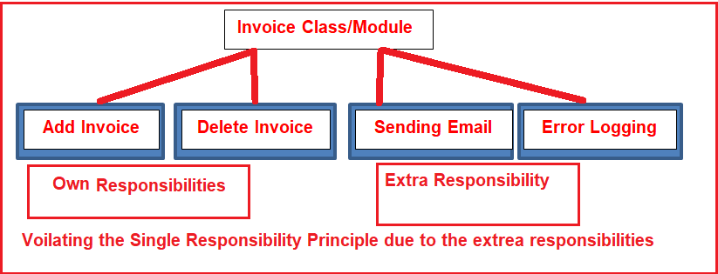
SRP(Single Responsibility Principle)
represents “S” in the SOLID
there should not be more than one reason for a class to change, or a level should always handle single functionality.
benefit of this principle is that it reduces coupling between the individual component of the software and Code.
For example, in case of more than one functionality in single Class, coupling is introduced between two functionalities. In case of change in one feature, the coupled functionality may break, which leads to more testing.
Notes:
1. DRY (Don’t repeat yourself)
Our first object-oriented design principle is DRY, as the name suggests DRY (don’t repeat yourself) means don’t write duplicate code, instead use Abstraction to abstract everyday things in one place.
If you have a block of code in more than two places, consider making it a separate method, or if you use a hard-coded value more than one time, make them public final constant. The benefit of this Object-oriented design principle is in maintenance.
It’s important not to abuse it, duplication is not for code, but for functionality.
It means if you have used standard code to validate OrderId and SSN, it doesn’t mean they are the same, or they will remain the same in the future.
By using standard code for two different functionality or thing, you tightly couple them forever, and when your OrderId changes its format, your SSN validation code will break.
So beware of such coupling and don’t combine anything which uses similar code but is not related. You can further check out the Basics of Software Architecture & Design Patterns in Java course on Udemy to learn more about writing the right code and best practices to follow while designing a system.

Slide 24
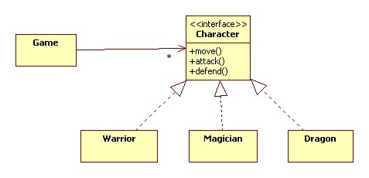
Open/Closed Principle:
“software entities (classes, modules, functions, etc.) should be open for extension, but closed for modification”
Notes:
2. Open/Closed Principle: This principle states that “software entities (classes, modules, functions, etc.) should be open for extension, but closed for modification” which means you should be able to extend a class behavior, without modifying it. Suppose developer A needs to release an update for a library or framework and developer B wants some modification or add some feature on that then developer B is allowed to extend the existing class created by developer A but developer B is not supposed to modify the class directly. Using this principle separates the existing code from the modified code so it provides better stability, maintainability and minimizes changes as in your code.

Slide 25
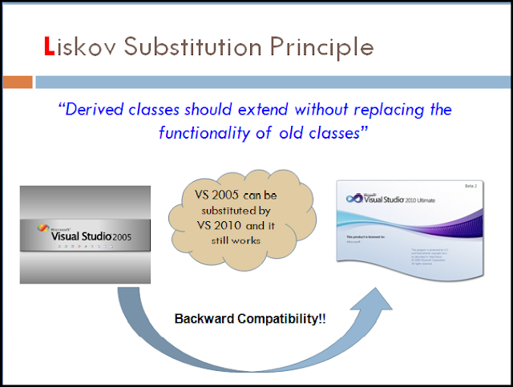
LSP(Liskov Substitution Principle)
Introduced by Barbara Liskov in 1987
As per this principle- Derived or child classes must be substitutable for their base or parent classes
This principle ensures that any class that is the child of a parent class should be usable in place of its parent without any unexpected behavior.
Eg: Square and Rectangle
Notes:
Liskov’s Substitution Principle: The principle was introduced by Barbara Liskov in 1987 and according to this principle “Derived or child classes must be substitutable for their base or parent classes“. This principle ensures that any class that is the child of a parent class should be usable in place of its parent without any unexpected behavior. You can understand it in a way that a farmer’s son should inherit farming skills from his father and should be able to replace his father if needed. If the son wants to become a farmer then he can replace his father but if he wants to become a cricketer then definitely the son can’t replace his father even though they both belong to the same family hierarchy. One of the classic examples of this principle is a rectangle having four sides. A rectangle’s height can be any value and width can be any value. A square is a rectangle with equal width and height. So we can say that we can extend the properties of the rectangle class into square class. In order to do that you need to swap the child (square) class with parent (rectangle) class to fit the definition of a square having four equal sides but a derived class does not affect the behavior of the parent class so if you will do that it will violate the Liskov Substitution Principle. Check the link Liskov Substitution Principle for better understanding.

Slide 26
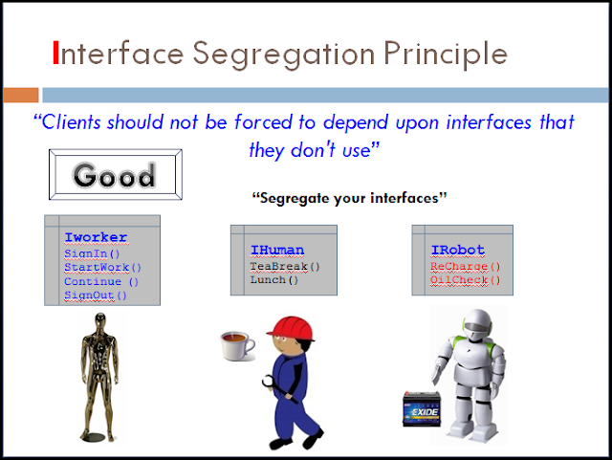
ISP(Interface Segregation Principle)
first principle that applies to Interfaces instead of classes in SOLID and it is similar to the single responsibility principle
“do not force any client to implement an interface which is irrelevant to them“
Avoid big long interface and give preference to many small client-specific interfaces
Eg: restaurants should keep separate menu cards for veg, nonveg, sweets etc so that the customer are not overloaded looking and searching for their want.
Notes:
Interface Segregation Principle: This principle is the first principle that applies to Interfaces instead of classes in SOLID and it is similar to the single responsibility principle. It states that “do not force any client to implement an interface which is irrelevant to them“. Here your main goal is to focus on avoiding fat interface and give preference to many small client-specific interfaces. You should prefer many client interfaces rather than one general interface and each interface should have a specific responsibility. Suppose if you enter a restaurant and you are pure vegetarian. The waiter in that restaurant gave you the menu card which includes vegetarian items, non-vegetarian items, drinks, and sweets. In this case, as a customer, you should have a menu card which includes only vegetarian items, not everything which you don’t eat in your food. Here the menu should be different for different types of customers. The common or general menu card for everyone can be divided into multiple cards instead of just one. Using this principle helps in reducing the side effects and frequency of required changes.

Slide 27
Dependency Inversion
make classes loosely coupled through abstraction.
Abstractions should not depend upon details. Details should depend upon abstractions.
Eg: Remote is depending upon battery to operate but not on a particular battery brand. So Remote is loosely coupled with brand.
Notes:
In object-oriented design, the dependency inversion principle is a specific methodology for loosely coupling software modules. When following this principle, the conventional dependency relationships established from high-level, policy-setting modules to low-level, dependency modules are reversed, thus rendering high-level modules independent of the low-level module implementation details. The principle states:^{[1]}
High-level modules should not import anything from low-level modules. Both should depend on abstractions (e.g., interfaces).
Abstractions should not depend on details. Details (concrete implementations) should depend on abstractions.
By dictating that both high-level and low-level objects must depend on the same abstraction, this design principle inverts the way some people may think about object-oriented programming.^{[2]}
The idea behind points A and B of this principle is that when designing the interaction between a high-level module and a low-level one, the interaction should be thought of as an abstract interaction between them. This not only has implications on the design of the high-level module, but also on the low-level one: the low-level one should be designed with the interaction in mind and it may be necessary to change its usage interface.
In many cases, thinking about the interaction in itself as an abstract concept allows the coupling of the components to be reduced without introducing additional coding patterns, allowing only a lighter and less implementation-dependent interaction schema.
When the discovered abstract interaction schema(s) between two modules is/are generic and generalization makes sense, this design principle also leads to the following dependency inversion coding pattern.

Slide 28
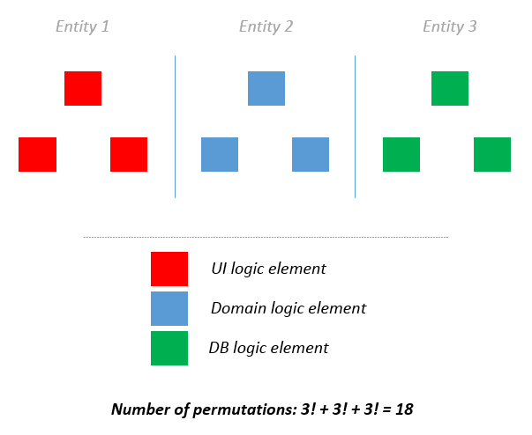
SOC(Separation of Concern)
partition a complicated application into different sections or domains
Each section has different jobs
Each section is independent of each other
becomes easier to maintain, update, and reuse the code
Eg: the MVC pattern where data (“model”), the logic (“controller”), and what the end-user sees (“view”) divided into three different sections and each part is handled independently.
Notes:
Separation of Concerns (SoC): Separation of Concerns Principle partition a complicated application into different sections or domains. Each section or domain addresses a separate concern or has a specific job. Each section is independent of each other and that’s why each section can be tackled independently also it becomes easier to maintain, update, and reuse the code. For example business logic (the content of the webpage) in an application is a different concern and user interface is a different concern in a web application program. One of the good examples of SoC is the MVC pattern where data (“model”), the logic (“controller”), and what the end-user sees (“view”) divided into three different sections and each part is handled independently. Saving of data to a database has nothing to do with rendering the data on the web.

Slide 29
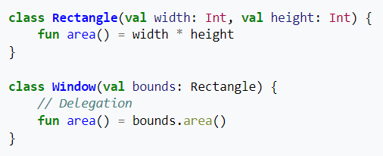
Delegation
Don’t do all work by yourself, delegate it to the respective class.
Benefit of this design principle is no duplication of code and easy to modify.
Eg: Event delegation
Eg: equals() and hashCode() method in Java.
the class Window delegates the area() call to its internal Rectangle object (its delegate).
Notes:
In software engineering, the delegation pattern is an object-oriented design pattern that allows object composition to achieve the same code reuse as inheritance.
In delegation, an object handles a request by delegating to a second object (the delegate). The delegate is a helper object, but with the original context. With language-level support for delegation, this is done implicitly by having self in the delegate refer to the original (sending) object, not the delegate (receiving object). In the delegate pattern, this is instead accomplished by explicitly passing the original object to the delegate, as an argument to a method.^{[1]} Note that "delegation" is often used loosely to refer to the distinct concept of forwarding, where the sending object simply uses the corresponding member on the receiving object, evaluated in the context of the receiving object, not the original object.

Slide 30
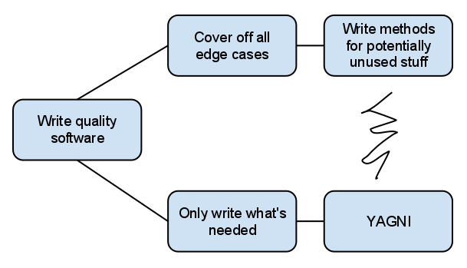
YAGNI(You Aren’t Going to Need It)
“don’t implement something until it is necessary”
Avoid code which is not required in future
Eg: class/functions etc not required currently but written now expecting those features later.
Notes:
YAGNI: Your software or program can become larger and complex if you are writing some code which you may need in the future but not at the moment. “You Aren’t Gonna Need It (YAGNI)” principle states that “don’t implement something until it is necessary” because in most of the cases you are not going to use that piece of code in future. Most of the programmers while implementing software think about the future possibility and add some code or logic for some other features which they don’t need at present. They add all the unnecessary class and functionality which they might never use in the future. Doing this is completely wrong and you will eventually end up in writing bloated code also your project becomes complicated and difficult to maintain. We recommend all the programmers to avoid this mistake to save a lot of time and effort.

Slide 31
KIS(Keep it simple)
Write simple code which is easy to understand
Break complex requirements into smaller chunks of code.
Eg: Avoid too many nested loops and find some alternatives.
Notes:
KISS: Nobody in programming loves to debug, maintain, or make changes in complex code. “Keep It Simple, Stupid (KISS)“ states that most systems work best if they are kept simple rather than making it complex, so when you are writing code your solution should not be complicated that takes a lot of time and effort to understand. If your code is simple then other developers won’t face any problem understanding the code logic and they can easily proceed further with your code. So always try to simplify your code using different approaches like breaking a complex problem into smaller chunks or taking out some unnecessary code you have written.

Slide 32
Patterns in Coding Practices
Patterns originated as an architectural concept by Christopher Alexander as early as 1977
Software design pattern is a general, reusable solution to a commonly occurring problem within a given context in software design.
Description or template for how to solve a problem that can be used in many different situations
Design patterns may be viewed as a structured approach to computer programming intermediate between the levels of a programming paradigm and a concrete algorithm.

Slide 33

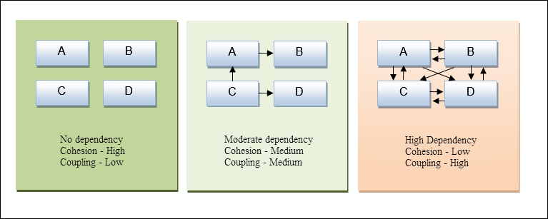
Advantages of Design Patterns
Design patterns not only bring standardization to your code, but also ensure that your code follows good programming principles, such as coupling and cohesion.

Slide 34
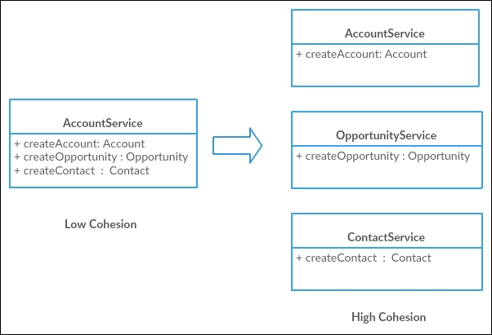
The following diagram shows how we converted low cohesion to high cohesion.

Slide 35
Other advantage of using design patterns
If testers know that a specific design pattern is used in an implementation, they can quickly relate to it. According to their past experience with design patterns, they can easily identify possible failure scenarios.
possible failure scenarios can be easily identified.
patterns allow developers to communicate using well-known, well understood names for software interactions.
Common design patterns can be improved over time, making them more robust than ad-hoc designs

Slide 36
Different Types of Design Patterns
Creational
Structural
Behavioral

Slide 37
Creational design patterns
These design patterns are all about class instantiation. This pattern can be further divided into class-creation patterns and object-creational patterns. While class-creation patterns use inheritance effectively in the instantiation process, object-creation patterns use delegation effectively to get the job done.
Abstract Factory
Creates an instance of several families of classes
Builder
Separates object construction from its representation
Factory Method
Creates an instance of several derived classes
Object Pool
Avoid expensive acquisition and release of resources
by recycling objects that are no longer in use
Prototype
A fully initialized instance to be copied or cloned
Singleton
A class of which only a single instance can exist

Slide 38
Structural design pattern
These design patterns are all about Class and Object composition. Structural class-creation patterns use inheritance to compose interfaces. Structural object-patterns define ways to compose objects to obtain new functionality.
Adapter
Match interfaces of different classes
Bridge
Separates an object’s interface from its implementation
Composite
A tree structure of simple and composite objects
Decorator
Add responsibilities to objects dynamically
Facade
A single class that represents an entire subsystem
Flyweight
A fine-grained instance used for efficient sharing
Private Class Data
Restricts accessor/mutator access
Proxy
An object representing another object

Slide 39
Behavioral design Pattern
These design patterns are all about Class's objects communication. Behavioral patterns are those patterns that are most specifically concerned with communication between objects.
Chain of responsibility
A way of passing a request between a chain of objects
Command: Encapsulate a command request as an object
Interpreter: A way to include language elements in a program
Iterator: Sequentially access the elements of a collection
Mediator: Defines simplified communication between classes
Memento: Capture and restore an object's internal state
Null Object: Designed to act as a default value of an object
Observer: A way of notifying change to a number of classes
State: Alter an object's behavior when its state changes
Strategy: Encapsulates an algorithm inside a class
Template method: Defer the exact steps of an algorithm to a subclass
Visitor: Defines a new operation to a class without change

Slide 40

Singleton Design Pattern
The singleton pattern is a design pattern that restricts the instantiation of a class to one object.
One of the simplest design patterns.
Eg: class with DB connection shared by multiple objects. Multiple objects creation may be costly for every object.
There can be a single configuration manager or error manager in an application that handles all problems instead of creating multiple managers.
Notes:
https://www.geeksforgeeks.org/singleton-design-pattern/
Singleton Design Pattern | Introduction
The singleton pattern is one of the simplest design patterns. Sometimes we need to have only one instance of our class for example a single DB connection shared by multiple objects as creating a separate DB connection for every object may be costly. Similarly, there can be a single configuration manager or error manager in an application that handles all problems instead of creating multiple managers.
Definition:
The singleton pattern is a design pattern that restricts the instantiation of a class to one object.
Let’s see various design options for implementing such a class. If you have a good handle on static class variables and access modifiers this should not be a difficult task.
Method 1: Classic Implementation
// Classical Java implementation of singleton
// design pattern
class Singleton
{
private static Singleton obj;
// private constructor to force use of
// getInstance() to create Singleton object
private Singleton() {}
public static Singleton getInstance()
{
if (obj==null)
obj = new Singleton();
return obj;
}
}
Here we have declared getInstance() static so that we can call it without instantiating the class. The first time getInstance() is called it creates a new singleton object and after that it just returns the same object. Note that Singleton obj is not created until we need it and call getInstance() method. This is called lazy instantiation.
The main problem with above method is that it is not thread safe. Consider the following execution sequence.
singleton
This execution sequence creates two objects for singleton. Therefore this classic implementation is not thread safe.
Method 2: make getInstance() synchronized
// Thread Synchronized Java implementation of
// singleton design pattern
class Singleton
{
private static Singleton obj;
private Singleton() {}
// Only one thread can execute this at a time
public static synchronized Singleton getInstance()
{
if (obj==null)
obj = new Singleton();
return obj;
}
}
Here using synchronized makes sure that only one thread at a time can execute getInstance().
The main disadvantage of this is method is that using synchronized every time while creating the singleton object is expensive and may decrease the performance of your program. However if performance of getInstance() is not critical for your application this method provides a clean and simple solution.
Method 3: Eager Instantiation
// Static initializer based Java implementation of
// singleton design pattern
class Singleton
{
private static Singleton obj = new Singleton();
private Singleton() {}
public static Singleton getInstance()
{
return obj;
}
}
Here we have created instance of singleton in static initializer. JVM executes static initializer when the class is loaded and hence this is guaranteed to be thread safe. Use this method only when your singleton class is light and is used throughout the execution of your program.
Method 4 (Best): Use “Double Checked Locking”
If you notice carefully once an object is created synchronization is no longer useful because now obj will not be null and any sequence of operations will lead to consistent results.
So we will only acquire lock on the getInstance() once, when the obj is null. This way we only synchronize the first way through, just what we want.
// Double Checked Locking based Java implementation of
// singleton design pattern
class Singleton
{
private static volatile Singleton obj = null;
private Singleton() {}
public static Singleton getInstance()
{
if (obj == null)
{
// To make thread safe
synchronized (Singleton.class)
{
// check again as multiple threads
// can reach above step
if (obj==null)
obj = new Singleton();
}
}
return obj;
}
}
We have declared the obj volatile which ensures that multiple threads offer the obj variable correctly when it is being initialized to Singleton instance. This method drastically reduces the overhead of calling the synchronized method every time.

Slide 41
Factory pattern
is a creational design pattern
i.e., related to object creation. In Factory pattern, we create object without exposing the creation logic to client and the client use the same common interface to create new type of object.
The idea is to use a static member-function (static factory method) which creates & returns instances, hiding the details of class modules from user.
A factory pattern is one of the core design principles to create an object, allowing clients to create objects of a library(explained below) in a way such that it doesn’t have tight coupling with the class hierarchy of the library.
Notes:
https://www.geeksforgeeks.org/design-patterns-set-2-factory-method/
Factory method is a creational design pattern, i.e., related to object creation. In Factory pattern, we create object without exposing the creation logic to client and the client use the same common interface to create new type of object. The idea is to use a static member-function (static factory method) which creates & returns instances, hiding the details of class modules from user.
A factory pattern is one of the core design principles to create an object, allowing clients to create objects of a library(explained below) in a way such that it doesn’t have tight coupling with the class hierarchy of the library.
What is meant when we talk about library and clients? A library is something which is provided by some third party which exposes some public APIs and clients make calls to those public APIs to complete its task. A very simple example can be different kinds of Views provided by Android OS.
Why factory pattern? Let us understand it with an example:
// A design without factory pattern
#include <iostream>
using namespace std;
// Library classes
class Vehicle {
public:
virtual void printVehicle() = 0;
};
class TwoWheeler : public Vehicle {
public:
void printVehicle() {
cout << "I am two wheeler" << endl;
}
};
class FourWheeler : public Vehicle {
public:
void printVehicle() {
cout << "I am four wheeler" << endl;
}
};
// Client (or user) class
class Client {
public:
Client(int type) {
// Client explicitly creates classes according to type
if (type == 1)
pVehicle = new TwoWheeler();
else if (type == 2)
pVehicle = new FourWheeler();
else
pVehicle = NULL;
}
~Client() {
if (pVehicle)
{
delete[] pVehicle;
pVehicle = NULL;
}
}
Vehicle* getVehicle() {
return pVehicle;
}
private:
Vehicle *pVehicle;
};
// Driver program
int main() {
Client *pClient = new Client(1);
Vehicle * pVehicle = pClient->getVehicle();
pVehicle->printVehicle();
return 0;
}
Output:
I am two wheelerWhat is the problems with above design? As you must have observed in the above example, Client creates objects of either TwoWheeler or FourWheeler based on some input during constructing its object. Say, library introduces a new class ThreeWheeler to incorporate three wheeler vehicles also. What would happen? Client will end up chaining a new else if in the conditional ladder to create objects of ThreeWheeler. Which in turn will need Client to be recompiled. So, each time a new change is made at the library side, Client would need to make some corresponding changes at its end and recompile the code. Sounds bad? This is a very bad practice of design.
How to avoid the problem? The answer is, create a static (or factory) method. Let us see below code.
// C++ program to demonstrate factory method design pattern
#include <iostream>
using namespace std;
enum VehicleType {
VT_TwoWheeler, VT_ThreeWheeler, VT_FourWheeler
};
// Library classes
class Vehicle {
public:
virtual void printVehicle() = 0;
static Vehicle* Create(VehicleType type);
};
class TwoWheeler : public Vehicle {
public:
void printVehicle() {
cout << "I am two wheeler" << endl;
}
};
class ThreeWheeler : public Vehicle {
public:
void printVehicle() {
cout << "I am three wheeler" << endl;
}
};
class FourWheeler : public Vehicle {
public:
void printVehicle() {
cout << "I am four wheeler" << endl;
}
};
// Factory method to create objects of different types.
// Change is required only in this function to create a new object type
Vehicle* Vehicle::Create(VehicleType type) {
if (type == VT_TwoWheeler)
return new TwoWheeler();
else if (type == VT_ThreeWheeler)
return new ThreeWheeler();
else if (type == VT_FourWheeler)
return new FourWheeler();
else return NULL;
}
// Client class
class Client {
public:
// Client doesn't explicitly create objects
// but passes type to factory method "Create()"
Client()
{
VehicleType type = VT_ThreeWheeler;
pVehicle = Vehicle::Create(type);
}
~Client() {
if (pVehicle) {
delete[] pVehicle;
pVehicle = NULL;
}
}
Vehicle* getVehicle() {
return pVehicle;
}
private:
Vehicle *pVehicle;
};
// Driver program
int main() {
Client *pClient = new Client();
Vehicle * pVehicle = pClient->getVehicle();
pVehicle->printVehicle();
return 0;
}
Output:
I am three wheelerIn the above example, we have totally decoupled the selection of type for object creation from Client. The library is now responsible to decide which object type to create based on an input. Client just needs to make call to library’s factory Create method and pass the type it wants without worrying about the actual implementation of creation of objects.
Thanks to Rumplestiltskin for providing above explanation.
Other examples of Factory Method:
Say, in a ‘Drawing’ system, depending on user’s input, different pictures like square, rectangle, circle can be drawn. Here we can use factory method to create instances depending on user’s input. For adding new type of shape, no need to change client’s code.
Another example: In travel site, we can book train ticket as well bus tickets and flight ticket. In this case user can give his travel type as ‘bus’, ‘train’ or ‘flight’. Here we have an abstract class ‘AnyTravel’ with a static member function ‘GetObject’ which depending on user’s travel type, will create & return object of ‘BusTravel’ or ‘ TrainTravel’. ‘BusTravel’ or ‘ TrainTravel’ have common functions like passenger name, Origin, destinationparameters.

Slide 42

Examples of Factory Pattern
1) in a ‘Drawing Art’ system, depending on user’s input, different pictures like square, rectangle, circle can be drawn. Here we can use factory method to create instances depending on user’s input. For adding new type of shape, no need to change client’s code.
2) In travel booking site, we can book train ticket as well bus tickets and flight ticket. In this case user can give his travel type as ‘bus’, ‘train’ or ‘flight’.
Here we have an abstract class ‘AnyTravel’ with a static member function ‘GetObject’ which depending on user’s travel type, will create & return object of ‘BusTravel’ or ‘ TrainTravel’. ‘BusTravel’ or ‘ TrainTravel’ have common functions like passenger name, Origin, destinationparameters.

Slide 43
Clean Code: Writing Functions or Methods
Your code needs to be optimized and changed if it has following properties:
Functions are too lengthy and do too much
Functions also have side effects that are difficult to comprehend or even test
The naming of functions and variables are vague
Fragile code: a small improvement unexpectedly damages certain components of the program
Bad or incomplete coverage of the code

Slide 44
Best practices: How to write plain, understandable, and easy to test functions
Functions should be small - Functions that have 200 or 300 lines are kind of messy functions. They should not be longer than 20 lines and mostly less than 10 lines
Block and indenting -keep the code blocks inside if, else and while statements minimal, preferably up to one line and that one line should be a function call.
avoid nesting such structures inside functions by moving the nested logic into another function.
Don't use long if, else, switch and while statements, because sometimes they make functions too big and messy.
Notes:
https://medium.com/swlh/clean-code-writing-functions-or-methods-4e6e53ff4ac2

Slide 45
Control Structures and Looping Example- Avoid If else
Too many If else | After avoiding if else
function greetings(timePhase:string) { if (timePhase === “morning”) { console.log(“Good Morning”); } else if (timePhase === “afternoon”) { console.log(“Good Afternoon”); } else if (timePhase === “evening”) { console.log(“Good Evening”); } else { console.log(“Good Night”); } } // calling greetings(); | function printGreeting(greeting:string) { console.log(greeting); } function greetings(timePhase: string) { let greeting = ‘Good’ + timePhase; printGreeting(greeting); }

Slide 46

3. Do one thing! (Single Responsibility Principle)-
One function must do only one thing. If a function is doing more than one thing, the function should be split up into more functions. 4. Function names should say what they do- Name the functions as per their purpose.
Eg: deleteCustomer(), retrieveNumber()

Slide 47
5. Remove duplicate code- Remove duplicate code and avoid repeating the same code. Instead create space to write common code and call it wherever required.
6. Remove dead code- Remove unnecessary code which is not required now.
Variables that are declared and not used anywhere in the code are most likely an error due to incomplete refactoring. Such variables take up space in the code and can lead to confusion by readers.
Bad code | After removing duplicate code
public void method() { int a = 1; int b = 2; int c = a+b; // duplicate int d = b+c; // duplicate } ... private int add(int a, int b) { return a+b; } | public void method() { int a = 1; int b = 2; int c = add(a,b); int d = add(b,c); } ... private int add(int a, int b) { return a+b; }
Notes:
Dead Code
Visual Code extension (ESLint) can analyze your code to quickly find problems such as unused variables, functions, and classes, etc.

Slide 48
8 Version Control Best Practices
Commit Changes Atomically
Commit Files With a Single Purpose — Not as a Backup
Write Good Commit Messages
Don’t Break Builds
Do Reviews Before Committing to a Shared Repository
Make Sure Every Commit Is Traceable
Follow Branching Best Practices
Protect Your Assets
Notes:
8 Version Control Best Practices
Here are 8 of the most critical version control best practices.
Commit Changes Atomically
One best practice is to commit changes atomically in version control.
All files in a commit are either committed together or not at all. No other user should see partial or incomplete changes.
A check-in is similar to a database transaction described by its ACID properties:
Atomic.
Consistent.
Isolated.
Durable.
Commit all files that belong to a task in a single operation to keep the project consistent at all times.
It's critical to apply best practices to commits. Good-quality commits will improve your project, making you more productive and successful.
Commit Files With a Single Purpose — Not as a Backup
Another best practice is committing files with a single purpose.
Each commit should have a single purpose. For example, fixing a bug or adding a new feature. If a single change makes multiple independent changes to your project, it can become difficult to read and to review. Backing out one of these changes then becomes more complex and unnecessarily time-consuming.
Remember: A commit is not a backup of your current state of your local files, even if it occurs at the end of the day.
By breaking down a larger task into smaller chunks, you can more readily understand and review the intent of changes. For example, you could break a task into infrastructure and refactoring tasks before making user-visible changes. Keeping the scope narrow also makes it easier to back out a bad commit.
Write Good Commit Messages
Another commit best practice is to write good commit messages.
Each commit should have a description that explains the why — but not necessarily the how — regarding the change. (How is usually deducible by comparing the file contents before and after the change.)
A good commit message makes it easier for a reviewer — and you — to understand the purpose of the commit later. A good commit message also references the issue ID(s) — or even the requirement ID(s) — that the commit addressed (if applicable).
Don’t Break Builds
Another version control best practice is to avoid breaking builds by doing complete commits.
Provide test cases and at least stubs for new APIs. This ensures every commit is usable by any other member in the team without breaking their build.
A complete commit is easier to propagate between branches. An incomplete commit of an API, for example, might build locally in your work area and pass all tests. But it could break in another team member’s work area.
Free Version Control + Built-In Best Practices
It's easier to apply version control best practices when you use the right tool. Get started with Perforce version control — Helix Core — for free for up to 5 users.
APPLY BEST PRACTICES WITH HELIX CORE
Do Reviews Before Committing to a Shared Repository
It’s also a best practice for version control to do reviews before committing to a shared repository.
A good commit is often reviewed before merging it to a shared repository. This is done either through a review system or a pull-request.
Reviews are a great way to get another perspective on a change and to improve code quality. Code reviews are also useful to increase code awareness within the team. This also enhances the team’s productivity through code reuse and higher quality of output.
More on code review best practices >>
Make Sure Every Commit Is Traceable
Another best practice for version control is to ensure traceability.
The project should be able to build and pass its test cases before and after the commit. If you notice a bug and want to track down the change that introduced the bug, you usually reset your working environment to a previous time to verify the bug is still there. (This is done either by hand or through some bisect facility.) If previous changes don’t even build, tracing down a bug becomes a lot more difficult.
For security and auditing, you must store the author of the change. You also need to store additional information, such as reviewer comments. A commit is also often associated with a specific issue or new feature request.
Following the version control best practices highlighted here will ensure that each commit can be backed out again if necessary. The best pre-commit reviews and build tests won’t always prevent unintended side effects that appear in later testing.
In such cases, it might be necessary to back out a commit. This returns the state of the project to an earlier time. This operation usually preserves history as well, so that the change can later be re-applied or analyzed and fixed as necessary.
Follow Branching Best Practices
It’s also important in version control to follow branching best practices. So, what is the best practice for branching?
There are many.
Using branches is important for managing releases, new features and bugs. But there can be some challenges in branching. For instance, changes in one branch often have to flow to other branches. This makes it critical to follow branching best practices to avoid merge conflicts, lost updates, and unintentional overwriting of existing changes.
Branching best practices include:
Try to keep things simple.
Have well-defined code branching policies.
Give codelines an owner.
Uses branches for releases or milestones.
Protect your mainline.
Merge down and copy up.
More on branching best practices >>
Protect Your Assets
Another version control best practice is to incorporate the right security measures to protect your assets.
Your version control system is a key repository for your organization. It stores and manages some of the most valuable assets in the company:
Your intellectual property (IP), which includes source code for applications used internally and/or by your customers.
Your product designs.
Export or compliance documentation.
Your videos, graphics, or images.
Business documents.
And much more.
Consider the value of these assets. And consider time and effort needed to recreate them after any potential disaster or the possible risk if they were leaked to a competitor. Then you’ll get some idea of why security should be a major consideration when choosing a version control tool, so you can always apply the best practices.
Best practices include:
Backup and failover.
Access control.
Visibility into activity.
https://www.perforce.com/blog/vcs/8-version-control-best-practices

Slide 49
RAW Codes: Stop these Insecure Coding Practice today
Hard-Coded Credentials
Improper Exception Handling
Lack of Rate Limiting
Single-Layered Defense
Improper Logging and Log handling
Notes:
1. Hard-Coded Credentials
One would hope that this security issue would no longer be a problem in 2020, but this insecure practice rears its head time and time again. Whether it’s the result of ignorance, poor planning, or outstanding tech-debt, there’s really no excuse to hard-code any kind of sensitive information in your code. MITRE even has a CWE for this (CWE-259).
Tens of thousands of cars were left exposed to thieves due to a hardcoded password | ZDNet
The maker of a popular vehicle telematics system has left hardcoded credentials inside its mobile apps, leaving tens of…
www.zdnet.com
Hundreds of Orpak gas station systems can be easily hacked thanks to hardcoded passwords
Homeland Security's cybersecurity agency says a popular gas station software contains several security vulnerabilities…
techcrunch.com
There are numerous open-source tools for detecting these sorts of values in a codebase. I’ve written on multiple occasions about Bandit, which is a SAST tool for python that has specific checks for hard-coded credential use. But there are many other tools that offer this functionality.
In addition to detecting rogue hard-coded credential use, there are also a number of tools and best practices that make it easier to manage and deploy applications that depend on secrets. Vault by Hashicorp is a very popular solution in this space — however, there are numerous solutions and design patterns and the tools and processes available will vary depending on how your application is architected and deployed.
2. Improper Exception Handling
I recently wrote about this insecure practice when looking at common pitfalls in python exception handling with regards to overly generic exception handling - but there are many other insecure ways to implement error handling in many different languages.
6 Exceptionally Common Pitfalls of Python Exception Handling
There’s a little more to remember than try..except
medium.com
In addition to overly generic error handling, insufficient error handling can also not only be a quality concern for software, but also a security concern. Many frameworks return stack traces and other error details by default if an uncaught exception occurs — while this can be extremely useful for developers when trying to debug a problem, it can also easily leak security and other implementation details which can be invaluable to attackers.
This is really bad for a lot of reasons, but I want to focus specifically on the exception handling.
This insecure practice is so prevalent (and serious) that MITRE has assigned it a CWE (CWE-396). If you want to learn more about how error handling can go awry, how to test for this type of vulnerability, or how to remediate this problem, OWASP has you covered.
3. Lack of Rate Limiting
Rate limiting can be used in multiple ways to serve a number of different purposes. Rate limiting can be useful for helping to define service or quality levels, for example in SaaS applications you may have different usage tiers. I would consider this type of rate limiting to be “Product Rate Limiting”, where the use of rate-limiting is not for security but rather defines the boundaries of acceptable use of a product.
Rate limiting can also be useful for security purposes. The most common use of security rate limiting is as a means of defense against Denial-of-Service attacks. By placing limits on the number of concurrent requests, or the number of requests during a set time period, you can prevent a user (or users) from monopolizing your application’s resources.
Beyond preventing DoS, rate limiting can also be used to slow the exfiltration of data if some kind of breach does occur. This is actually something I’ve seen first-hand. An adversary discovered an API that allowed access to other users’ account details as long as there was an authenticated session. Though the breach went unknown for a short period of time, thankfully due to rather an aggressive rate limiting across the API, the attacker was not able to exfiltrate too many customer records before they were discovered and stopped.
When implementing rate limiting generally it is best to place near the edge of your application, either in a reverse proxy such as nginx, or in an API gateway. The rate-limiting algorithm you choose and limits to use will depend entirely on your product, users, and use-cases, but even the process of thinking about these factors can be a useful thought experiment. If you absolutely cannot implement rate limiting for some reason, you should at least implement some sort of logging or metrics around APIs so you can be alerted if there is a deviation from normal activity levels.
4. Single-Layered Defense
Often times as developers we can be lulled into a false sense of security by the use of mitigating controls. For example, if you’ve ever added validation to an API, or regex checks to a form field to prevent some kind of unwanted input, you may now think you aren’t susceptible to attacks such as SQI or XSS — but this isn’t true. With any sufficiently complex application, you should always strive to utilize defense in depth. In the example above this means not just doing input validation, but also ensuring that inputs are properly escaped before being stored, executed, or returned.
Security folks are typically fairly paranoid bunch, and for good reason — they know that attackers are intelligent, persistent, and motivated and can spend much more time trying to break your application than you can realistically spend trying to craft defenses. Developers should be more paranoid and look to add as many layers of defense as are practical.
5. Improper Logging and Log handling
If you’ve ever had to do any kind of debugging on a deployed or remote application, you’ll agree that well-placed detailed logging can be a godsend. However, it’s easy to take this too far. In one rather egregious example, I’ve seen in real life, an application was logging a user’s API keys for each request. While I’m sure the developer that added this log thought they could be useful — imagine how their customers would feel to know that their credentials were basically available to anyone who was able to view a log file.
Additionally, in the age of GDPR, developers need to be aware of what constitutes Personally Identifiable Information (PII) and ensure that it is not included in application logs. I’ve seen this many times where identifiable information, such as full names, email addresses, and more sent out to logs.

Slide 50
Non-compliant VS Compliant Code
Notes:
https://www.geeksforgeeks.org/coding-standards-and-guidelines/

Slide 51

Secure Coding
set of practices that applies security considerations to how software will be coded and encrypted to best defend against cyber attack or vulnerabilities.
introduce safeguards that reduce or eliminate the risk of leaving security vulnerabilities in code.
prevent many cyber-attacks
Notes:
Secure Coding
What is secure coding?
Secure coding is a set of practices that applies security considerations to how software will be coded and encrypted to best defend against cyber attack or vulnerabilities. Defects, bugs, and logic flaws are the primary cause of commonly exploited software vulnerabilities, and security professionals have discovered that most vulnerabilities stem from a relatively small number of common software programming errors. Secure coding standards introduce safeguards that reduce or eliminate the risk of leaving security vulnerabilities in code.
After defining a project and its requirements for both users and systems, considerations on best practices and plans for secure code are determined and implemented with these requisites in mind. At the build phase in the software development lifecycle, secure coding practices combined with early phase security measures—like static application security testing (SAST)—help ensure that security programs penetrate across technology layers.
Why do we need secure coding?
Secure code will help to prevent many cyber-attacks from happening because it removes the vulnerabilities many exploits rely on. If your software has a security vulnerability it can be exploited. The WannaCry ransomware attack of 2017, exploited a Windows protocol vulnerability.
What is the risk of insecure coding?
Insecure coding practices not only leave your customers at risk, but they will impact the reputation of your company. This is why it is important to have secure code.
Security vulnerabilities that affect code
1. Insufficient Logging and Monitoring: Insufficient logging and monitoring processes are dangerous. This leaves your data vulnerable to tampering, extraction, or even destruction.
2. Injection Flaws: Injection flaws occur when untrusted data is sent as part of a command or query. The attack can then trick the targeted system into executing unintended commands.
3. Sensitive Data Exposure: Sensitive data — such as addresses, passwords, and account numbers — must be properly protected.
4. Using Components with Known Vulnerabilities: Components are made up of libraries, frameworks, and other software modules. Often, the components run on the same privileges as your application. If a component is vulnerable, it can be exploited by an untrustworthy agent.
5. Cross-Site Scripting (XSS): Untrustworthy agents can take advantage of cross-site scripting flaws to execute their own scripts in the targeted system.
6. Broken Authentication: Authentication and session management application functions need to be implemented correctly. If they aren't, it creates a software vulnerability that can be exploited by untrustworthy agents to gain access to personal information.
7. Broken Access Control: User restrictions must be properly enforced.
8. XML External Entities (XXE): XML is a popular data format that is used in web services, documents, and image files. You need an XML parser to understand XML data. But if it's poorly configured and the XML input that contains a reference to an external entity, it's dangerous.
9. Security Misconfiguration: Security misconfigurations can be a result of: Insecure default configurations, Incomplete configurations, misconfigured HTTP headers or detailed error messages that contain sensitive information.
10. Insecure Deserialization: Deserialization flaws often result in remote code execution.
Best Practices for securing code
Data input validation: This covers numerous aspects of data source and data validation. For example, the length and date range of a piece of data. Data validation checks help to secure web applications from cyber-attacks.
Authentication and password management: Coding also involves software architecture.
Cryptographic Practices: The guide suggests that any cryptographic modules used, be FIPS 140-2 or an equivalent standard compliant.
Error Handling and Logging: This is a crucial area and one that if not coded securely can leak data.
Data Protection: The guidelines for the protection of data include advice on storing passwords securely and how to avoid data leaks via HTTP GET.
Communication Security: Advisories on how to protect data during transit, for example, using TLS connections.
Adopt a secure coding standard. Develop and/or apply a secure coding standard for your target development language and platform.

Slide 52
Best Practices for securing code
Data input validation: This covers numerous aspects of data source and data validation. For example, the length and date range of a piece of data. Data validation checks help to secure web applications from cyber-attacks.
Authentication and password management: Coding also involves software architecture.
Cryptographic Practices: The guide suggests that any cryptographic modules used, be FIPS 140-2 or an equivalent standard compliant.
Error Handling and Logging: This is a crucial area and one that if not coded securely can leak data.
Data Protection: The guidelines for the protection of data include advice on storing passwords securely and how to avoid data leaks via HTTP GET.
Communication Security: Advisories on how to protect data during transit, for example, using TLS connections.
Adopt a secure coding standard. Develop and/or apply a secure coding standard for your target development language and platform.

Slide 53
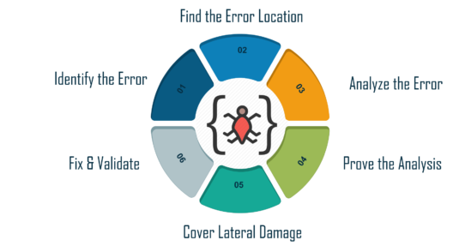
Debugging defects and documenting
Debugging is the process of fixing a bug in the software.
It reports an error condition immediately.
provides maximum useful information of data structures and allows easy interpretation.
can avoid complex one-use testing code to save time and energy in software development.
Document and Track the defects
Debugging Tools
Notes:
https://www.whitehatsec.com/glossary/content/secure-coding
1. Identify the Error: A bad identification of an error can lead to wasted developing time. It is usual that production errors reported by users are hard to interpret and sometimes the information we receive is misleading. It is import to identify the actual error.
2. Find the Error Location: After identifying the error correctly, you need to go through the code to find the exact spot where the error is located. In this stage, you need to focus on finding the error instead of understanding it.
3. Analyze the Error: In the third step, you need to use a bottom-up approach from the error location and analyze the code. This helps you in understanding the error. Analyzing a bug has two main goals, such as checking around the error for other errors to be found, and to make sure about the risks of entering any collateral damage in the fix.
4. Prove the Analysis: Once you are done analyzing the original bug, you need to find a few more errors that may appear on the application. This step is about writing automated tests for these areas with the help of a test framework.
5. Cover Lateral Damage: In this stage, you need to create or gather all the unit tests for the code where you are going to make changes. Now, if you run these unit tests, they all should pass.
Software Testing Fundamentals Course
Watch The Course Preview
6. Fix & Validate: The final stage is the fix all the errors and run all the test scripts to check if they all pass.
Debugging Strategies
It is important to study the system in depth in order to understand the system. It helps the debugger to construct different representations of systems that are to be debugged.
Backward analysis of the problem traces the program backward from the location of failure message in order to identify the region of faulty code. You need to study the region of defect thoroughly to find the cause of defects.
Forward analysis of the program involves tracking the program forward using breakpoints or print statements at different points in the program. It is important to focus on the region where the wrong outputs are obtained.
You must use the past experience of the software to check for similar problems. The success of this approach depends on the expertise of the debugger.

Slide 54
OOP Best practices
Recursion Introduction
Use the same interface for communication with components of the same type. It allows the swapping of those components for other components of the same type without breaking existing code.
If you need additional functionality, either create proxy objects that implement the interface, or add it by subclassing (hence the name "Recursion Introduction"). Even if there is no recursion happening, it appears to operate in the same manner.
Eliminate Case Analysis
Avoid testing to see if an object is an instance of a particular class. Usually, if you think you need that approach then a redesign will help immensely.
Reduce the Number of Arguments
Methods with a half-dozen arguments are hard to read, and can usually be accomplished with an object that represents that set of arguments. It also makes it easier to track down the problems.
Notes:
https://excalibur.apache.org/framework/best-practices.html

Slide 55
Reduce the Size of Methods
Most of your methods should only need to be a few lines long. Methods that are very long (like 50 lines or so) are too complex, and should be considered guilty of bad design until proven innocent.
The Top of the Class Hierarchy Should be Abstract
In many cases it is beneficial to provide an abstract base class to extend for your specializations. The majority of the functionality and behavior is well defined. This makes it easier to decipher what the intents of the interface designer were.
Minimize Accesses to Variables
This point formalizes the principles of data hiding. Try not to expose class attributes to other classes, but protect them by methods. If an attribute changes name, then you only have one place to update the code instead of hundreds.
Subclasses Should be Specializations
A [subclass] "is a" [superclass]. If what you are trying to do is make a Component into a ComponentManager, then you are violating the spirit of the framework. A better approach is to use containment in that case (i.e. a [class] "has a" [external class]).

Slide 56
Split Large Classes
If a class has 50+ methods, then it is most likely trying to do too much. Look at separating the functionality into separate components. Like methods that are too long, classes that violate this rule should be considered guilty of wrong design until proven innocent.
Factor Implementation Differences Into Subcomponents
If a subclass implements a method completely different from the superclass, then it is not really a specialization. It should be split off from that class hierarchy tree.
Separate Methods that Do Not Communicate
Sometimes in building a framework you run into a case where you have different views of the same data. In these cases, you can have some attributes that describe how to generate the data, and some attributes that describe the data itself. It is better to separate these two views into separate classes. The semantics are different enough to justify this solution.
Eliminate Implicit Parameter Passing
Just because two methods share the same information within the class does not mean that it should be done in that manner. Many times, the attribute that is shared should be passed as a parameter of the method instead of directly accessing the attribute.

